Slide 1
DRAFT
THIS DECK IS STILL DRAFT

Slide 2
Presentation Notes
This entire deck, including demos but not the checkpoints, must be delivered in 10 minutes or less. Participants need time to do the actual lab.
Talking points are very brief. Even if you’ve seen the same slide in the past, take note of the new talking points.

Slide 4
Introduction to Windows 10 IoT Core
Code Labs

Slide 5

Disruptive Forces Enabling IoT
Moore’s Law
Metcalf‘s Law
Koomey’s Law
Transistors
Computations
per KWh
10,000,000,000
1.E+14
1,000,000,000
1.E+12
100,000,000
1.E+10
10,000,000
1.E+08
1,000,000
1.E+06
100,000
1.E+04
10,000
1.E+02
1,000
1.E+00
1970
1980
1990
2000
2010
1940
1975
2010
And more importantly:
what can you do by combining and analyzing signals from all of these IoT devices?
Notes:
“Moore’s law tells us that computers are still getting more powerful. Koomey’s law tells us that they also require a lot less power than they did in the past. And Metcalf’s law observes that computers are more valuable when they are more connected. All of these things apply directly to, and in fact enable, IoT.”
Reference:
The graphs are illustrations, not exact values
Moore's law is the observation that the number of transistors in a dense integrated circuit doubles approximately every two years.
Metcalfe's law states that the value of a telecommunications network is proportional to the square of the number of connected users of the system (n²).
Koomey’s law describes a long-term trend in the history of computing hardware. The number of computations per joule of energy dissipated has been doubling approximately every 1.57 years. This trend has been remarkably stable since the 1950s (R² of over 98%) and has actually been somewhat faster than Moore’s law. Jonathan Koomey articulated the trend as follows: "at a fixed computing load, the amount of battery you need will fall by a factor of two every year and a half."

Slide 6
IoT is gaining momentum
2010
Alarm clock
Refrigerator
Automobile
VoIP phone
Computer
Printer
Media player
Microwave
HOME
WORKPLACE
HOME
Coffee maker
Smart scale
Oven
Cell phone
HVAC
Vending
Security
Television
Notes:
“IoT is gaining momentum. Back just a few years ago, the uses for IoT were pretty limited. Mostly smart embedded devices doing PC-like things, as well as many of the scenarios carried over from decades of embedded computing.”

Slide 7
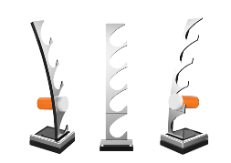
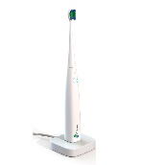
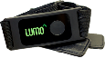
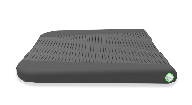


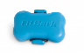

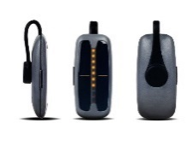
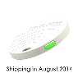
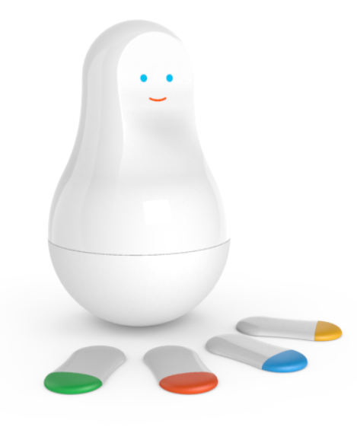
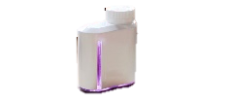

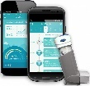
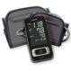
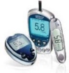
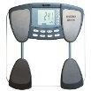
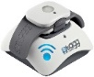
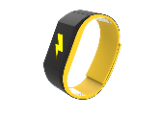
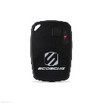
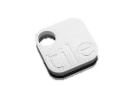
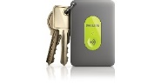
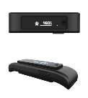
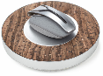


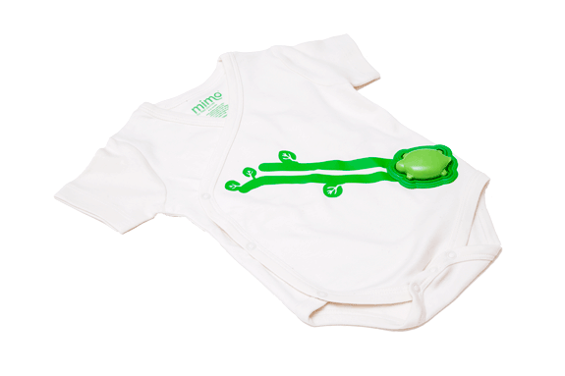
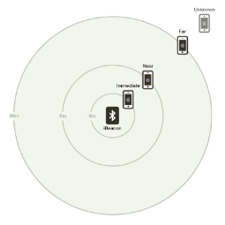
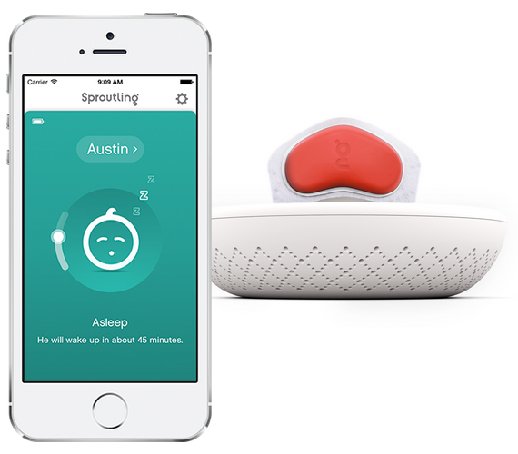


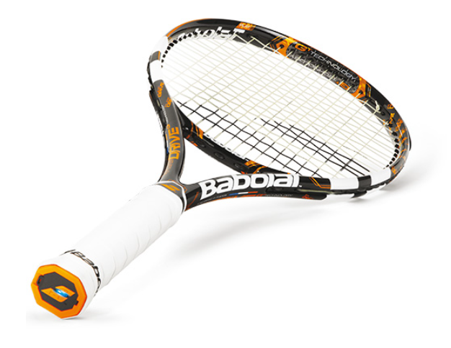
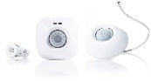
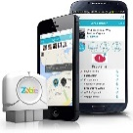

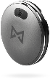
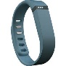

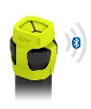
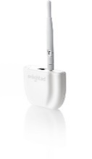



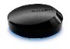
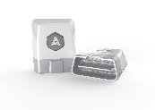
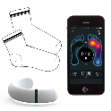
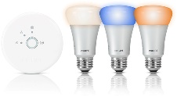
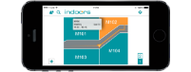
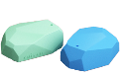


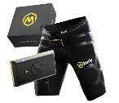
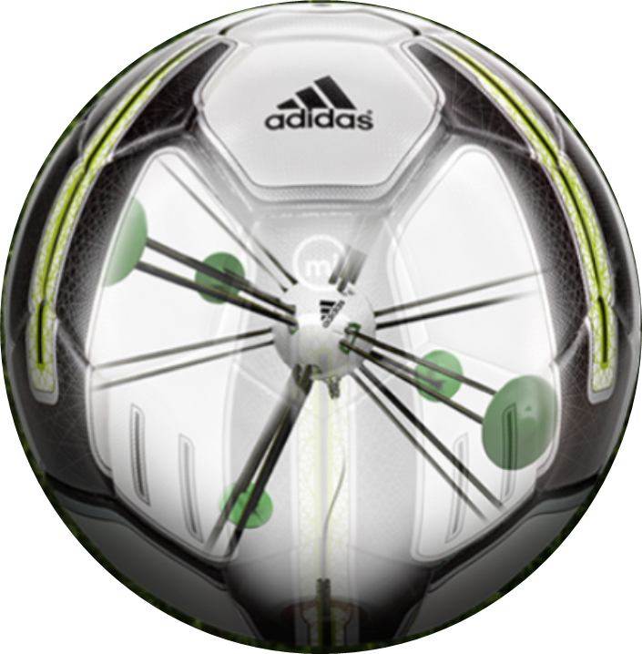


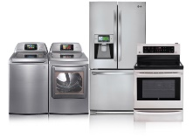

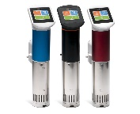
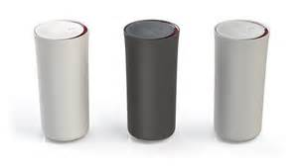
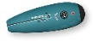
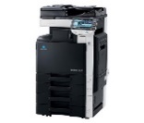
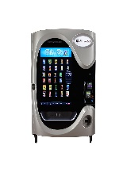
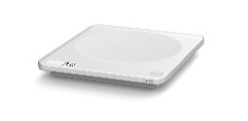
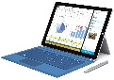
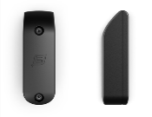
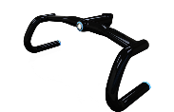
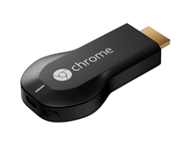

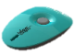


































Medication adherence
Health monitoring
Pet tracking
Behavior modification
Object tracking
Child and elder monitoring
Sports and fitness
Indoor navigation
Trip tracking and car health
Smart lighting
Beacons and proximity
COMMUTE
COMMUTE
HOME
WORKPLACE
HOME
Smart appliances
Food and nutrition tracking
Identity
Office equipment
Smart vending machines
Bike ride stats and protection
Air conditioning and temperature control
Sleep tracking
Environmental sensors
Information capture
Control
Home security
Home automation
Leak detection
Garden, lawn and plant care
New devices and sensors
Entertainment systems
Notes:
“But today, we’re seeing IoT everywhere, with devices that are smarter because they are both more powerful and more connected.”

Slide 8
IoT is an inflection point
Hardware
is cheap
Connectivity
is pervasive
Development
is easier
New Innovative Scenarios
Huge benefits
fuel demands
Notes:
“Today, you can buy a very powerful device for $35 or less, connect it to services like Azure, develop for it using commercial-grade tools like Visual Studio, and save your company, or your clients, a ton of money due to the intelligence gained and automation performed.”

Slide 9
Windows 10 IoT Core
Notes:
So let’s take a look at our free client operating system that addresses part of this category: Windows 10 IoT Core

Slide 10













Windows on a full range of devices…
2-in-1s (Tablet or Laptop)
Classic Laptop
Desktops & All-in-Ones
Phone
Phablet
Small Tablet
Large Tablet
Windows 10
Surface Hub
Xbox
Holographic
IoT
Notes:
“With Windows 10, we’ve combined the code and work from the desktop, Windows Phone, and Xbox into a single core operating system and one application platform (UWP) and with that OS, we support a full range of devices from phones to tablets to PCs to IoT devices like the Raspberry Pi 3.
Each has its own tailored experience, but Windows 10 runs on all”

Slide 11
...with a consistent programming model
Windows Universal Platform
Common & Consistent APIs
Languages
C++ /CX
C#, VB
JS
Wiring
Python
Node.js
others
UI Frameworks
HTML
Xaml
DirectX
APIs
WinRT
Win32
.NET
Wiring
others
Deployment and Execution
APPX
Xcopy
App Isolation
Notes:
“The Universal Windows Platform (UWP) programming model defines a full set of APIs supported by languages including C++, C#/VB, and JavaScript. Additionally, for IoT apps and more, we’ve added support for Wiring, Python, and Node.js
Part of UWP is our programming model for IoT. Through that extension component, you get low-level access to GPIO, PWM, SPI, I2C, and more.”

Slide 12

…on some pretty cool devices
Notes:
“Windows 10 for IoT is officially available on three families of boards:
Raspberry Pi 2 and 3
Minnowboard Max (essentially the guts of a tablet)
Dragonboard (essentially the guts of a phone)
Additionally, companies like Toradex have ported Windows 10 IoT Core to modules running other processors, like the Nvidia Tegra 3.”

Slide 13

Windows 10 IoT Core
UWP Programming model + IoT extensions. Binary compatible with desktop, phone, Xbox, and other UWP targets.
Runs a single foreground application, plus any number of your UWP background tasks.

Slide 14
Windows 10 IoT Core
App owns the whole user interface. Optimized for embedded use.
Deployment and debugging in Visual Studio.
Development-time management through web site, PowerShell, SSH, and more.

Slide 15
Continuum of making
Tinkerer
Education
Hobbyist
Prototyper
(personal, Enterprise, etc.)
Small Scale Production / Crowd Funding
Large Scale Production/ Enterprise
A continuum rather than distinct points on a journey, makers span the entire process from learning to production. Each have different product and support needs.
Notes:
(This is to answer the “why” of IoT core and of makers in general)
“Microsoft views making as a continuum, starting from tinkerers and education through to hobbyists, pre-production, prototyping, production, and more. It’s not just about a student in school, but also about the person prototyping the next cool product at a fortune 500. Windows 10 IoT Core has been designed for all of these makers.”

Slide 16

GHI FEZ HAT
On-Board Analog Input and PWM chips.
Two DC Motor Drivers, suitable for building small robots.
Terminal Blocks for wiring in DC motors without the need for soldering.
Two Servo Motor Connections + Servo power.
Two Multi Color LEDs, connected to PWM for thousands of colors. Single Red LED.
Temperature and Light sensors
Accelerometer.
more
Notes:
“Because most of you will also participate in the Azure parts of this series, we’re using an integrated sensor HAT-like (Hardware Attached on Top) board from GHI
This board was developed especially for Azure labs and simplifies connectivity to sensors in a way that lets you focus on Azure. It includes libraries which abstract away the underlying IO, much like you would have if you coded for a shield on an Arduino.”

Slide 17
Lab Setup
Direct wired Ethernet for Deploy/Debug
WiFi for Azure (Lab 3)
Development PC
Raspberry Pi 3 with FEZ HAT
Notes:
“At each of your stations is a Raspberry Pi 3, hard-wired to the development PC. This is for deployment and debugging. The WiFi connection from the Pi 3 is for connection to Azure in follow-on lab modules.”

Slide 18
IoT Lab modules
1
Learn about Windows 10 IoT Core on the Raspberry Pi 3
2
Learn about Microsoft Azure IoT
3
Learn how to connect Windows 10 IoT Core with Microsoft Azure
4
Concurrent Open Hack
Notes:
“If you are interested in the underlying IO and other capabilities on devices like the Raspberry Pi, or want to explore more with Azure and devices, we also have the Open Hack in this same room, starting on Day 2.”

Slide 19
Hello World
Quick run-through for deploying your first app

Slide 20
Lab

Slide 21

Checkpoint 1
Notes:
Time: TBD

Slide 22
Checkpoint 2
Notes:
Time: TBD

Slide 23
Checkpoint 3
Notes:
Time: TBD

Slide 24
Wrap-up
Notes:
Do this in the last 5 minutes of the event

Slide 26
Where can I find imagery?
A few great places to start…
Brand Central: A resource for information on the Microsoft brand
https://microsoft.sharepoint.com/teams/BrandCentral/
Microsoft News Center A great place for the latest and greatest
www.microsoft.com/en-us/news
Xbox Wire Media Assets library
http://news.xbox.com/media/
Featured Devices: PC, tablet and phone hardware imagery and marketing materials
https://www.featureddevices.com/
Presentation Resources: Presentation guidelines and PowerPoint templates
https://microsoft.sharepoint.com/teams/BrandCentral/Pages/Presentations.aspx
Respect intellectual property rights
Photography and graphics used in presentations, for both internal and external audiences, must be owned by Microsoft or licensed appropriately.
Microsoft has agreements in place with several stock providers. More information about approved stock providers and instructions for requesting licenses is available here: https://microsoft.sharepoint.com/teams/MediaAcquisition/Pages/knowledgeBase.aspx
Avoid intellectual property theft: Do not use photos or graphics copied from the web in presentations. When in doubt, consult with LCA http://lcaweb/CTP/Copyrights/Third-Party-Content-Use/Pages/default.aspx

Slide 27
Preferred text layout (no bullets)
Main topic 1: size 40pt
Size 20pt for the subtopics
Size 20pt for the subtopics
Main topic 2: size 40pt
Size 20pt for the subtopics
Size 20pt for the subtopics
Main topic 3: size 40pt
Size 20pt for the subtopics
Size 20pt for the subtopics

Slide 28
Preferred text layout (no bullets)
Main topic 1: size 40pt
Size 20pt for the subtopics
Size 20pt for the subtopics
Main topic 2: size 40pt
Size 20pt for the subtopics
Size 20pt for the subtopics
Main topic 3: size 40pt
Size 20pt for the subtopics
Size 20pt for the subtopics

Slide 29

Adjusting list levels
Main topic 1: size 40pt
Size 20pt for the subtopics
Size 20pt for the subtopics
Main topic 2: size 40pt
Size 20pt for the subtopics
Size 20pt for the subtopics
Main topic 3: size 40pt
Size 20pt for the subtopics
Size 20pt for the subtopics
Use the “Decrease List Level” and “Increase List Level” tools on the Home Menu to change text levels.
Try this:
Place your cursor in any row of text to the left that says “Size 20pt for subtopics”
Next click the Home tab, and then on the “Decrease List level” tool. Notice how the line moves up one level.
Now try placing your cursor in one of the “Main topic…” lines of text. Click the “Increase List Level” tool and see how the text is pushed in one level
Use these 2 tools to adjust your text levels as you work

Slide 30
Bullet points layout with subtitle Subtitle
Example of a bulleted slide with a subhead
Set the slide title to “Sentence case”
Set subheads to “Sentence case”
Hyperlink style
www.microsoft.com

Slide 31


Slide palette info
The PowerPoint palette for this template has been built for you and is shown below. Avoid using too many colors in your presentation.
Select the 4th color from the left for subheads and 1st level non-bulleted text color, or wherever “color” text is preferred over the default black/white text
Accent colors 1-6 – (6 Theme Colors to the far right)
Text
Dark 2
Accent 1
Accent 2
Accent 3
Accent 4
Accent 5
Accent 6
Use Accent 1 as the main accent color. Use Accent 2 and Accent 3 when additional colors are needed.
Use Accents 4-6 sparingly – only when more colors are necessary.

Slide 32
Charts
For content: Type is what articulates the message. Text doesn’t need to be bulleted. Text size can reinforce and impact.

Slide 33
Charts
For content: Type is what articulates the message. Text doesn’t need to be bulleted. Text size can reinforce and impact.

Slide 34
Table
Column 1 | Column 2 | Column 3 | Column 4 | Column 5
Text | Text | Text | Text | Text
Text | Text | Text | Text | Text
Text | Text | Text | Text | Text
Text | Text | Text | Text | Text
Text | Text | Text | Text | Text
Text | Text | Text | Text | Text
Text | Text | Text | Text | Text
Text | Text | Text | Text | Text
This is a content box, always 24pts and sentence case.

Slide 35
Diagram with text
This is a content box, always 24pts and sentence case.
Windows Style App
<audio src=“…”>
<video src=“…”>
Windows Runtime (WinRT)
Playback/Preview
(Media Engine)
Capture
(Capture Engine)
Transcode
Streaming
(Sharing Engine)
Media Foundation
Audio/Video
Source
Video
Decoder
Video
Effect 1
Video
Effect N
Video
Encoder
Audio/Video
Sink
Audio
Decoder
Audio
Effect 1
Audio
Effect N
Audio
Encoder

Slide 36
Diagram without text
New Windows 8 app
<audio src=“…”>
<video src=“…”>
Windows Runtime (WinRT)
Playback/Preview
(Media Engine)
Capture
(Capture Engine)
Transcode
Streaming
(Sharing Engine)
Media Foundation
Audio/Video
Source
Video
Decoder
Video
Effect 1
Video
Effect N
Video
Encoder
Audio/Video
Sink
Audio
Decoder
Audio
Effect 1
Audio
Effect N
Audio
Encoder

Slide 37
Video

Slide 38
Demo
Speaker name

Slide 39
Photo layout 1
Notes:
Use developer type photo.

Slide 40




Microsoft brand guidelines
Looking for more slide resources?
Brand guidelines for PowerPoint templates is a separate slide deck that provides an overview of the Microsoft brand, guidelines, resources, tips and much more.
A few of the slides are shown at right.
Download from: https://microsoft.sharepoint.com/teams/BrandCentral/Pages/Presentations.aspx

Slide 41
Section title

Slide 42
Section title
Notes:
Make text black in master.

Slide 43
“If you could only sense how important you are to the lives of those you meet; how important you can be to the people you may never even dream of. There is something of yourself that you leave at every meeting with another person.”
FRED ROGERS

Slide 44
Software code slide
This slide layout uses Consolas, a monotype font which is ideal for showing software code.

Slide 45
Notes (hidden)
Some speakers at Microsoft like to use this slide for hidden “notes slides”.
Delete it if you don’t want to use it.
NEXT: <next slide title>

Slide 46
Call to Action
Use this slide to list resources, white papers, videos and links.
Let attendees know their next step after seeing this session.
Re-visit Build on Channel 9.
Continue your education at Microsoft Virtual Academy online.

Slide 47



Please Complete An Evaluation Form Your input is important!
Required Slide
*delete this box when your slide is finalized
SAMPLE
or
Notes:
Update phone image to a Microsoft phone.

Slide 48
Evaluate this session
Required Slide
*delete this box when your slide is finalized
Speakers: This slide will be updated during the scrub process with a unique QR code. Attendees scan the QR code to access the eval for your session.
SAMPLE
Notes:
Speakers: Please note this slide will be updated with your session’s QR code during the scrub process which is outlined on side 3. Attendees can scan the QR code for access to your session’s eval.

Slide 50
Presentation title goes here
Speaker name
Title

Slide 51
Preferred text layout (no bullets)
Main topic 1: size 40pt
Size 20pt for the subtopics
Size 20pt for the subtopics
Main topic 2: size 40pt
Size 20pt for the subtopics
Size 20pt for the subtopics
Main topic 3: size 40pt
Size 20pt for the subtopics
Size 20pt for the subtopics

Slide 52
Bullet points layout with subtitle Subtitle
Example of a bulleted slide with a subhead
Set the slide title to “Sentence case”
Set subheads to “Sentence case”
Hyperlink style
www.microsoft.com

Slide 53


Slide palette info
The PowerPoint palette for this template has been built for you and is shown below. Avoid using too many colors in your presentation.
Accent colors 1-6 – (6 Theme Colors to the far right)
Accent 1
Accent 2
Accent 3
Accent 4
Accent 5
Accent 6
Use Accent 1 as the main accent color. Use Accent 2 and Accent 3 when additional colors are needed.
Use Accents 4-6 sparingly – only when more colors are necessary.

Slide 54
Charts
For content: Type is what articulates the message. Text doesn’t need to be bulleted. Text size can reinforce and impact.

Slide 55
Charts
For content: Type is what articulates the message. Text doesn’t need to be bulleted. Text size can reinforce and impact.

Slide 56
Table
Column 1 | Column 2 | Column 3 | Column 4 | Column 5
Text | Text | Text | Text | Text
Text | Text | Text | Text | Text
Text | Text | Text | Text | Text
Text | Text | Text | Text | Text
Text | Text | Text | Text | Text
Text | Text | Text | Text | Text
Text | Text | Text | Text | Text
Text | Text | Text | Text | Text
This is a content box, always 24pts and sentence case.

Slide 57
Diagram with text
This is a content box, always 24pts and sentence case.
Windows Style App
<audio src=“…”>
<video src=“…”>
Windows Runtime (WinRT)
Playback/Preview
(Media Engine)
Capture
(Capture Engine)
Transcode
Streaming
(Sharing Engine)
Media Foundation
Audio/Video
Source
Video
Decoder
Video
Effect 1
Video
Effect N
Video
Encoder
Audio/Video
Sink
Audio
Decoder
Audio
Effect 1
Audio
Effect N
Audio
Encoder

Slide 58
Diagram without text
New Windows 8 app
<audio src=“…”>
<video src=“…”>
Windows Runtime (WinRT)
Playback/Preview
(Media Engine)
Capture
(Capture Engine)
Transcode
Streaming
(Sharing Engine)
Media Foundation
Audio/Video
Source
Video
Decoder
Video
Effect 1
Video
Effect N
Video
Encoder
Audio/Video
Sink
Audio
Decoder
Audio
Effect 1
Audio
Effect N
Audio
Encoder

Slide 59
Video

Slide 60
Demo
Speaker name

Slide 61
Photo layout 1
Notes:
Use developer type photo.

Slide 62
“If you could only sense how important you are to the lives of those you meet; how important you can be to the people you may never even dream of. There is something of yourself that you leave at every meeting with another person.”
FRED ROGERS

Slide 63
Section title

Slide 64
Section title
Notes:
Make text black in master.

Slide 65
Software code slide
This slide layout uses Consolas, a monotype font which is ideal for showing software code.

Slide 66
Notes (hidden)
Some speakers at Microsoft like to use this slide for hidden “notes slides”.
Delete it if you don’t want to use it.
NEXT: <next slide title>

Slide 67
Call to Action
Use this slide to list resources, white papers, videos and links.
Let attendees know their next step after seeing this session.
Re-visit Build on Channel 9.
Continue your education at Microsoft Virtual Academy online.

Slide 68
Please Complete An Evaluation Form Your input is important!
Required Slide
*delete this box when your slide is finalized
SAMPLE
or
Notes:
Update phone image to a Microsoft phone.

Slide 69
Evaluate this session
Required Slide
*delete this box when your slide is finalized
Speakers: This slide will be updated during the scrub process with a unique QR code. Attendees scan the QR code to access the eval for your session.
SAMPLE
Notes:
Speakers: Please note this slide will be updated with your session’s QR code during the scrub process which is outlined on side 3. Attendees can scan the QR code for access to your session’s eval.

Slide 70
Notes:
Dark gray background.

